Slide 1

DISTRIBUTED ORGANIZATIONS
BENGÜL BAYRAKTAROĞLU
Notes:
In the previous chapter, we described the organization in terms of its basic structure. Today, many organizations operate in multiple locations.
So, In this chapter we will review the design alternatives for geographic distribution and
we will describe how organization structure can be used to support different forms of knowledge exchange.

Slide 2
Introduction
Distributed organizational designs
enable firms to coordinate work across national and other geographic boundaries
meet the knowledge needs of our increasingly service-oriented economy
First, structures for spanning geography
Second, structures for managing knowledge exchange
Notes:
This chapter consists of two analyses.
First, structures for spanning geography
Second, structures for managing knowledge exchange

Slide 3
Managing a business centered in one location
Become an expert
Know the people, the culture and the general settings
Your firm becomes highly knowlegeable
Build efficiency and effectiveness
Managing relationships with suppliers, distributors, government regulators, and other entities
Share a common language, laws, customs, and ways of doing business
Notes:
When a organization is founded it typically starts by doing business in one location.
As the executive managing a business centered in one location,
you become an expert doing business in that environment.
You know the people, the culture and the general settings in which your firm operates.
Your firms becomes highly knowlegeable in that environment.
This allows you to build efficieny and effectivenes based on local knowledge.
Managing relationships with suppliers, distributors, goverment regulators is straight forward when all are co-located.
You share a common language, laws, customs, and ways doing business.

Slide 4
Managing a business distant from your home locale
Face significant organizational challenges
Managing people and processes across distance and culture.
Important whether you are managing large organization or small work team.
Should you organize around the talent or function, regardless of locale?
Should you organize based on geopraphic location?
Should you own or directly manage operations in distal locales?
To what extend should you rely on information technology, versus travel and face-to-face meetings, to link people together ?
Notes:
There are some questions to be answered.

Slide 5
Example
Merloni Elettrodomestici, (an Italian-owned company with headquarters in Paris. )
Initially limited to regional operations in Italy.
The company soon had a sales force distributed across Europe and later acquired or built facilities in Germany, France, the UK, Spain etc.
How to organize a growing distibuted enterprise?
Merloni first created country-based organizations, all coordinated through the Paris office; later company consolidated by product line, creating several centers of excellence that coordinated all operations for a given product throughout Europe. Then a matrix reporting structure was added to link research and development activities with brand-based activities. In more recent years the firm has created a “developing market division”, with country-based organizations in Russia and China while maintaining product—line organizations in Europe. Merloni’s experience illustrates the kinds of design choices that firms have to make as they expand their businesses around the world.

Slide 6
As an executive;
you face these kinds of design decisions in your organizations.
you decide how work is to be allocated and coordinated across place and space.
Workers
are in different time zones,
speak different languages,
have different holiday schedules, work habits and skill sets
Notes:
All these can be challanges you face in a distributed organization

Slide 7
STRUCTURES FOR SPANNING GEOPRAPHY
A simple and powerful way to describe a firm’s approach to managing across distance is in terms of
optimal sourcing
local responsiveness
Optimal sourcing
The decision to locate operations in the place that brings the greatest advantage to firm in terms of customer contact, cost efficiency, human resource skills need, or other objectives.
If a firm locates work based on placing as close as possible to resource supply, then optimal sourcing is high.
If locates work based on other factors, such as close to headquarters or in a particular city, country or geopraphic region, then optimal sourcing is low.

Slide 8
For example; a software company may choose to locate
If it requires the technical skills for new products, it may locate in the Silicon Valley of the US or Sophia Antipolis on the Cote D’ Azur of France in order to be close to programmers and engineers .
If the firm seeks low-cost, high skilled labor, it may locate one or more facilities in Hyderabad or New Delphi.
If the market reach customers in developing markets of Russia, the company may locate officies in Novgorod, Kursk, or Vladivostok.

Slide 9
Local responsiveness:
The decision to distribute work in many locales rather than consalidating in one location.
Distributing work to many locales maximizes firm’s flexibility to complete work tasks any time, any place.
→Optimal sourcing and local responsiveness represents tradeoffs in organizational design that corresspond to the firm strategies of exploitation and exploration.
To extent that your firm pursues
exploitation, you should organize work to be high in optimal sourcing
exploration, you should organize work to be high in local responsiveness.

Slide 10

Optimal Sourcing
High
International
Transnational
Low
Locally Responsive
High
Global
Multi-domestic
Low
The organizational design space
Notes:
This figure displays the organizational design space of optimal sourcing and local responsiveness along with the four types of distributed organizational design relate to these dimensions:
1 global
2 international
3 multidomesctic
4 transnational

Slide 11
global
Centralized approach to organizing and thus yields the advantage of high centralization of decision making.
Organization is not organized to be locally responsive or to yield optimal sourcing
Organization concentrates its work activities in one locale, «home base»
Consistent with a strategy of offering similar products or services worldwide.
Notes:
A distributed organizational design

Slide 12
Consider the case of software company that offers project management software solutions to customers all over the world.
The company is head-quarted in the US, in Arlington, Virginia.
The management, developers, and support staff are located there.
Sales representatives may call on customers throughout the world, and contract workers from locales other than Virginia may be hired to complete specific tasks.
Support staff may make site visits to customers throughout the world.
But the management of all these work activities is centered at the Virginia headquarters.
There is little customization of work as a function of geography. Instead, work is managed from the corporate center, the arrangement of this work is controlled at the center(US locale).

Slide 13
International
A distributed organizations design in which work is located as close as possible to the resources the organization needs to do work, wherever they may be in the world.
Work is located close to resource inputs, not as a function or customer location or to spread operations across locales or regions of the world.
Products are designed with domestic customers in mind, and international business is sought as a way of extending the product lifecycle and replicating its home market success.

Slide 14
The firm expects little knowledge flows from foreign operations.
Local responsiveness is low because the products and services tend to be standardized rather than customized to location.
The organization is “tall” rather than flat; that is the vertical differentiation is high.

Slide 15
Suppose our software development firm, located in Arlington, Virginia, has grown such that its project management software products have sold to customers throughout the US, Western Europe, Japan, Taiwan, and Australia.
The company now services thousands of customers in these locales. This has created a huge workload for corporate operations; further, the company cannot find enough programmers in Virginia to meet software support needs of customers. The company may open two operations in India, perhaps one in New Delphi and one in Hyderabad, where high-quality customer relations and technical skills are available at a relatively low cost of labor. The New Delphi operation serves as a customer call center. The Hyderabad operation serves as a technical support center where programmers work on software fixes and upgrades. This is an international type of organizational design.

Slide 16
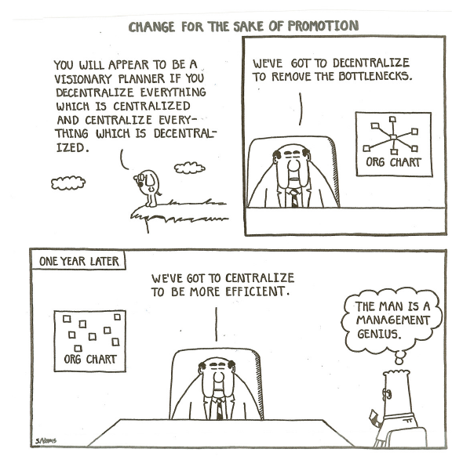

Slide 17
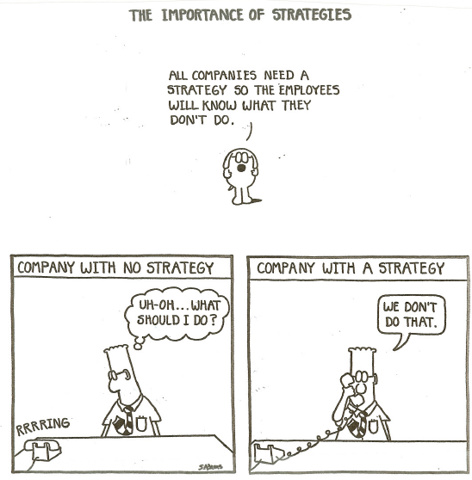

Slide 18
Multi-domestic
A decentralized, geography based approach to organizing in which operations are customized to specific countries or regions, offering unique products or services to meet local preferences.
Divisions or other operations are located in different locales to yield local responsiveness to customers, not to yield optimal sourcing.
Headquarters allows each country manager to operate independently and pursue local responsiveness.
This type of organizational design is flat in shape rather than tall, meaning that work practices will vary as function of locale.

Slide 19
With this strategy, managers recognize and emphasize differences among national markets.
Firms with limited international experience often find multi-domestic strategy an easy option as they can delegate many tasks to their country managers (or foreign distributors, franchisees, or licensees, where they are used).

Slide 20
Managers have little incentive to share knowledge and experience with those in other countries, leading to duplication of activities and reduced economies of scale.
Limited information sharing also reduces the possibility of developing knowledge-based competitive advantage.
Focus on competition in each market
It leads to inefficient manufacturing, redundant operations, a proliferation of products designed to meet local needs, and generally higher costs of international operations than other designs.
Notes:
Supports growth via exploration of new products and services
A good choice if the source of growth is geographically based.
However requires more investment

Slide 21
Consider our example of the software development firm, headquarted in Arlinton, Virginia.
Suppose the firm seeks to grow the service side of its business, offering a variety of project management services to customers that use its project management software.
If the firm assesses the environment and determines that service needs are quite different in developed countries vs. developing countries, and, further, that there are major differences in service needs in Asian countries vs. Western countries, the firm could adopt a multi-domestic organizational design for management of its service business.
The firm might establish regional operations in Japan or Singapore to service the many developed economies of Asia. It might then establish a country-based operation in mainland China to explore the unique needs of that market. Similary, it might locate an operation in London from which it would service the Western European market, with additional officies in Moscow and Budapest, to service the unique needs of these more volatile, growing economies.

Slide 22
transnational
A distributed organizations design that blends the international and multi-domectic structures to yield both the location advantages of regional or country-based design and economic efficiencies of optimal sourcing.
Organization develops customized offerings by region while at the same time gaining efficiencies through worldwide centers of operations.

Slide 23
Managed well, the transnational design can bring the benefits of high efficiency and effectiveness.
Organizing production, marketing, and other value-chain activities on a global scale.
Optimizing local responsiveness and flexibility.
Facilitating global learning and knowledge transfer.
Coordinating competitive moves --how the firm deals with its competitors, on a global, integrated basis.
Difficult to achieve because of simultaneous requirements for strong central control and coordination to achieve efficiency and local flexibility and decentralization to achieve local market responsiveness

Slide 24
Suppose you managed the software company decribed earlier, with corporate headquarters in Arlington, Virginia.
You might take an optimal sourcing approach to locating a technical support or call center, perhaps placing both facilities in India despite low presence of customers in that country.
At the same time you might locate sales and service operations in London, Moscow, Budapest, Japan, and China, so that you reach your major strategic markets. These facilities might operate some-what differently, depending on the needs of customer in the regions they have serve and the degree of investment your company intends to make in the particular region.

Slide 25
NEED FOR KNOWLEDGE EXCHANGE
Once the location decisions have been made, management must be adept at coordinating among the firm’s distributed operations.
This means that there must be a knowledge exchange support among various geographic locales.

Slide 26
Structures for managing knowledge exchange
Knowledge: information that corresponds to a particular content.
Knowledge exchange: sharing of information that requires interpretation, or intelligence, to fully understand and apply.
To structure in order to maximize efficiency and effectiveness of knowledge exchange is a major challenge for the distributed organization.
Knowledge exchange can help the organization to increase its information capacity, that is, the amount of information that the organization can process.
A company which has different groups producing different types of products can still benefit from knowledge processed by other groups such as development of research platforms, testing methods, statistical analyses, production methods, sales opportunities, etc.

Slide 27
Structures for managing knowledge exchange
Two reliable mechanisms in order to manage knowledge exchanges:
Virtualization: degree of boundary-spanning or organizational reach that a company uses as the basis for knowledge exchange.
IT infusion: extent to which a firm relies on information technology-based systems, including data processing and computer-based communication systems, to manage knowledge exchange
Nearly all organizations today rely on IT, but some are rely more heavily on IT-based systems, whereas others rely more heavily on face-to-face or manual systems.

Slide 28
Structures for managing knowledge exchange
Organizations that are high in virtualization:
look outward,
link teams or business units,
have connected parties outside the organizational boundary in order to gain knowledge.
Organizations that are low in virtualization:
Take a more inward focus,
Gain knowledge by developing it inside corporate boundaries, inside specialized groups, or by acquiring knowledge externally and then improving it inside the firm.
A company acquiring another one in order to capture new capabilities from the marketplace is an example of these companies.

Slide 29
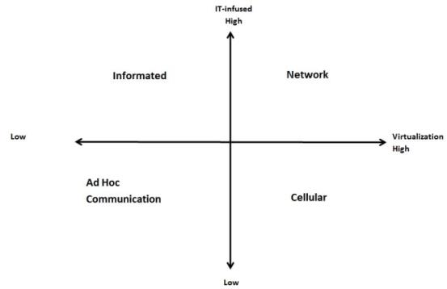

Slide 30
Ad hoc communications
→ Primary knowledge exchange approach used by firms that score low both on virtualization and IT-infusion.
→ Person-to-person contacts or small groups (2-10 people) whose members are all from inside the organization to share knowledge on an as-needed basis.
These groups consist of people who are closest to the work at hand.
They are typically temporary, come together to meet a specific task need.
They are usually appointed by management.
→ Ad hoc communications manage knowledge exchange on an as-needed basis.
→ There are not pre-established routines for conducting work. It depends on the particular task at hand, members of the group and even the manager.
→ They can be effective in generating and transfering information to meet the specific knowledge needs of a given project, event, or client.

Slide 31
Informated
Approach in which computer and related systems are used to manage information up and down the organization.
Informated organizations are low in virtualization and high in IT infusion.
Computer technology is used in the design and monitoring of work processes.
→ Examples of informated organizations:
Modern banks use information systems to monitor customer inquiries and call center operators to improve customer support and have greater worker productivity.
UPS links information systems inside trucks with package-tracking systems that allow customers, workers and management to track the deliveries.
Informated organizations increases the possibilities for creative ways of rearranging and linking work activities.
It is more suitable for the businesses such as hospitals, consulting, and education since they increasingly rely on intense knowledge exchange to meet client needs.

Slide 32
Cellular
These organizations are small, autonomous groups or business units that mostly self-govern and can grow, reproduce and form relations with other units as needed.
They have high virtualization ability but low IT infusion.
→Compared to the informated organizations,
They focus more on the ability of business units to import and export knowledge while improving information inside.
They have more variability in the process of knowledge exchange within subunits.
→Compared to ad hoc communication-based organizations,
They develop extensive relationships with external parties for knowledge acquisition.
Like ad hoc communications, cellular organizations rely heavily on information between people for knowledge exchange.
Interpersonal contact is as important as information technology.
This type of communication is more suitable for research firms and divisional forms where highly varied approaches to knowledge development and exchange are needed across the subunits.

Slide 33
Network
→ Network organizations score high both on virtualization and IT-infusion.
In order to meet the organization’s knowledge needs, they
Link the units within the form with one another and
Develop active linkages between internal units and external organizations.
They are mostly in the form of strategic alliances, research partnerships, and consortia.
Impossible to create network organizations without the use of modern information technology.
Network can operate as a ring, a star, or a web that ties the subunits of the firm.

Slide 34
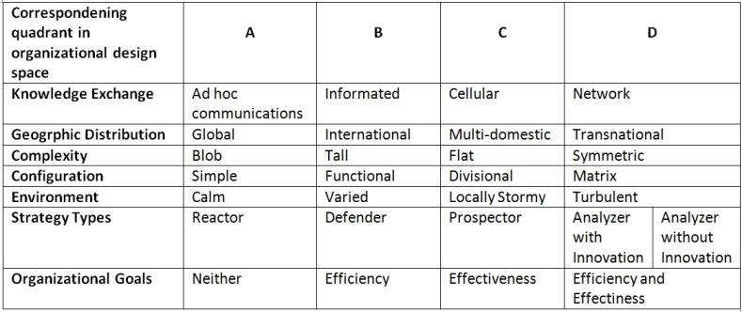
FIT AND MISFIT TABLE

Slide 35
Fit and misfits
The table summarizes the four columns in the organizational design space introduced thus far.
Firms that have more characteristics in the same column are said to have good fit among their goals, strategy, and structure.
Firms in column A:
Simple in structure
Manage knowledge on an ad hoc, informal basis
Don’t have a strong organizational form; instead, task design depends on the needs of work at hand.
Tend to do well with centralized, headquarters-based management: a global approach makes sense.
Works well when the environment is stable or the organization is small.

Slide 36
Fit and misfits
Firms in column B:
Organize knowledge by speciality, thus informative approaches.
Often in the form of international firms.
Functionally designed firms that distribute work based on optimal sourcing.
Firms in column C:
Has a divisional structure thus when it distributes globally, a multi-domestic form of organization fits better.
Utilize cellular approach in order to ensure knowledge exchange.
Supports a prospector strategy.

Slide 37
Fit and misfits
Firms in column D:
Most ideal approach for the geographically distributed firms with high information-processing demands.
Develop network forms of knowledge exchange
Suitable for a turbulent environment
Both exploration and exploitation are strategies.

Slide 38
Interpreting the table
It is almost impossible for an organization’s all of the components to fall in the same column.
When this is the case:
Decide whether these misfits are causing loss in the firm’s ability to meet its goals.
If not, it may be fine to live with the misfits.
However, future conditions should be considered when taking the decision.
Misfits that are in adjacent columns are less of a concern than those that are in opposing columns.

Slide 39
Conclusion
Organizational design is an ongoing process.
Design components and their fit with one another must be developed on a continuing basis.
Success of the implementation of the systems depend on the employee adoption.
Managers may try to enforce for cellular type of knowledge sharing but if employees find ad hoc systems more flexible and suitable for them, then the firm may drift as time goes by.

Slide 40
THANKS FOR LISTENING
ANY QUESTIONS?

